Slide 1
Visually UXposed
hAkim
Ivan

Slide 2

Uxprobe
Tech start up that targets IT managers for application improvement
Tracks how users interact with the software
Measure success and satisfaction of users

Slide 3
Data
Fleet management app for transport companies
Allows companies to manage their fleets and save money
Logs of system activities and user activities in the application
5 Variables and about 1 million data points
Session ID
User ID
Task Name
Event Name
Time Stamp
Secondary data set with satisfaction

Slide 4
Goals
To help the project manager decide what features to remove or improve in an application
The goal of the product manager is to decide on what aspect of their application to modify - such as adding or removing features, restructuring menus
This is based on patterns of use and satisfaction of final users with the current state of their application
Other criteria are budget, programming complexity, user requirement, management decisions, but these are not included in the visualization goals

Slide 5
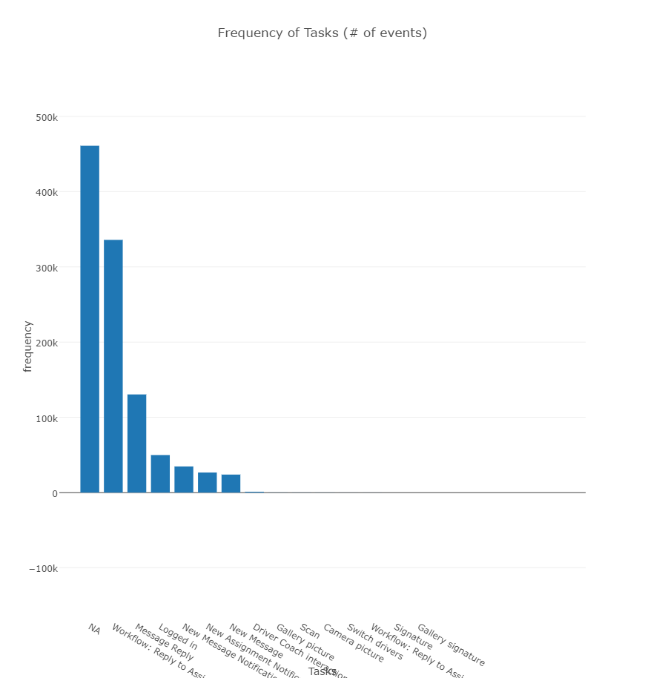
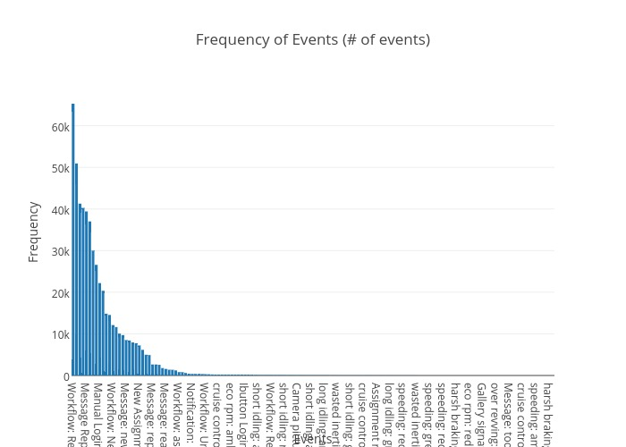
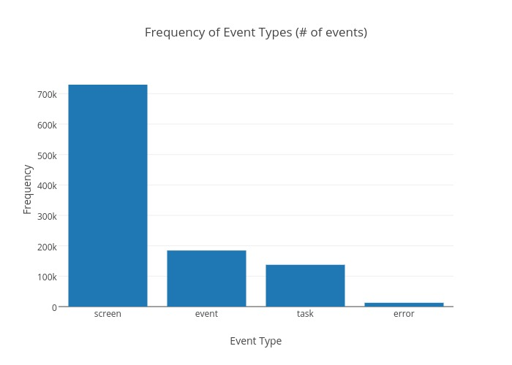
Data Distribution

Slide 6
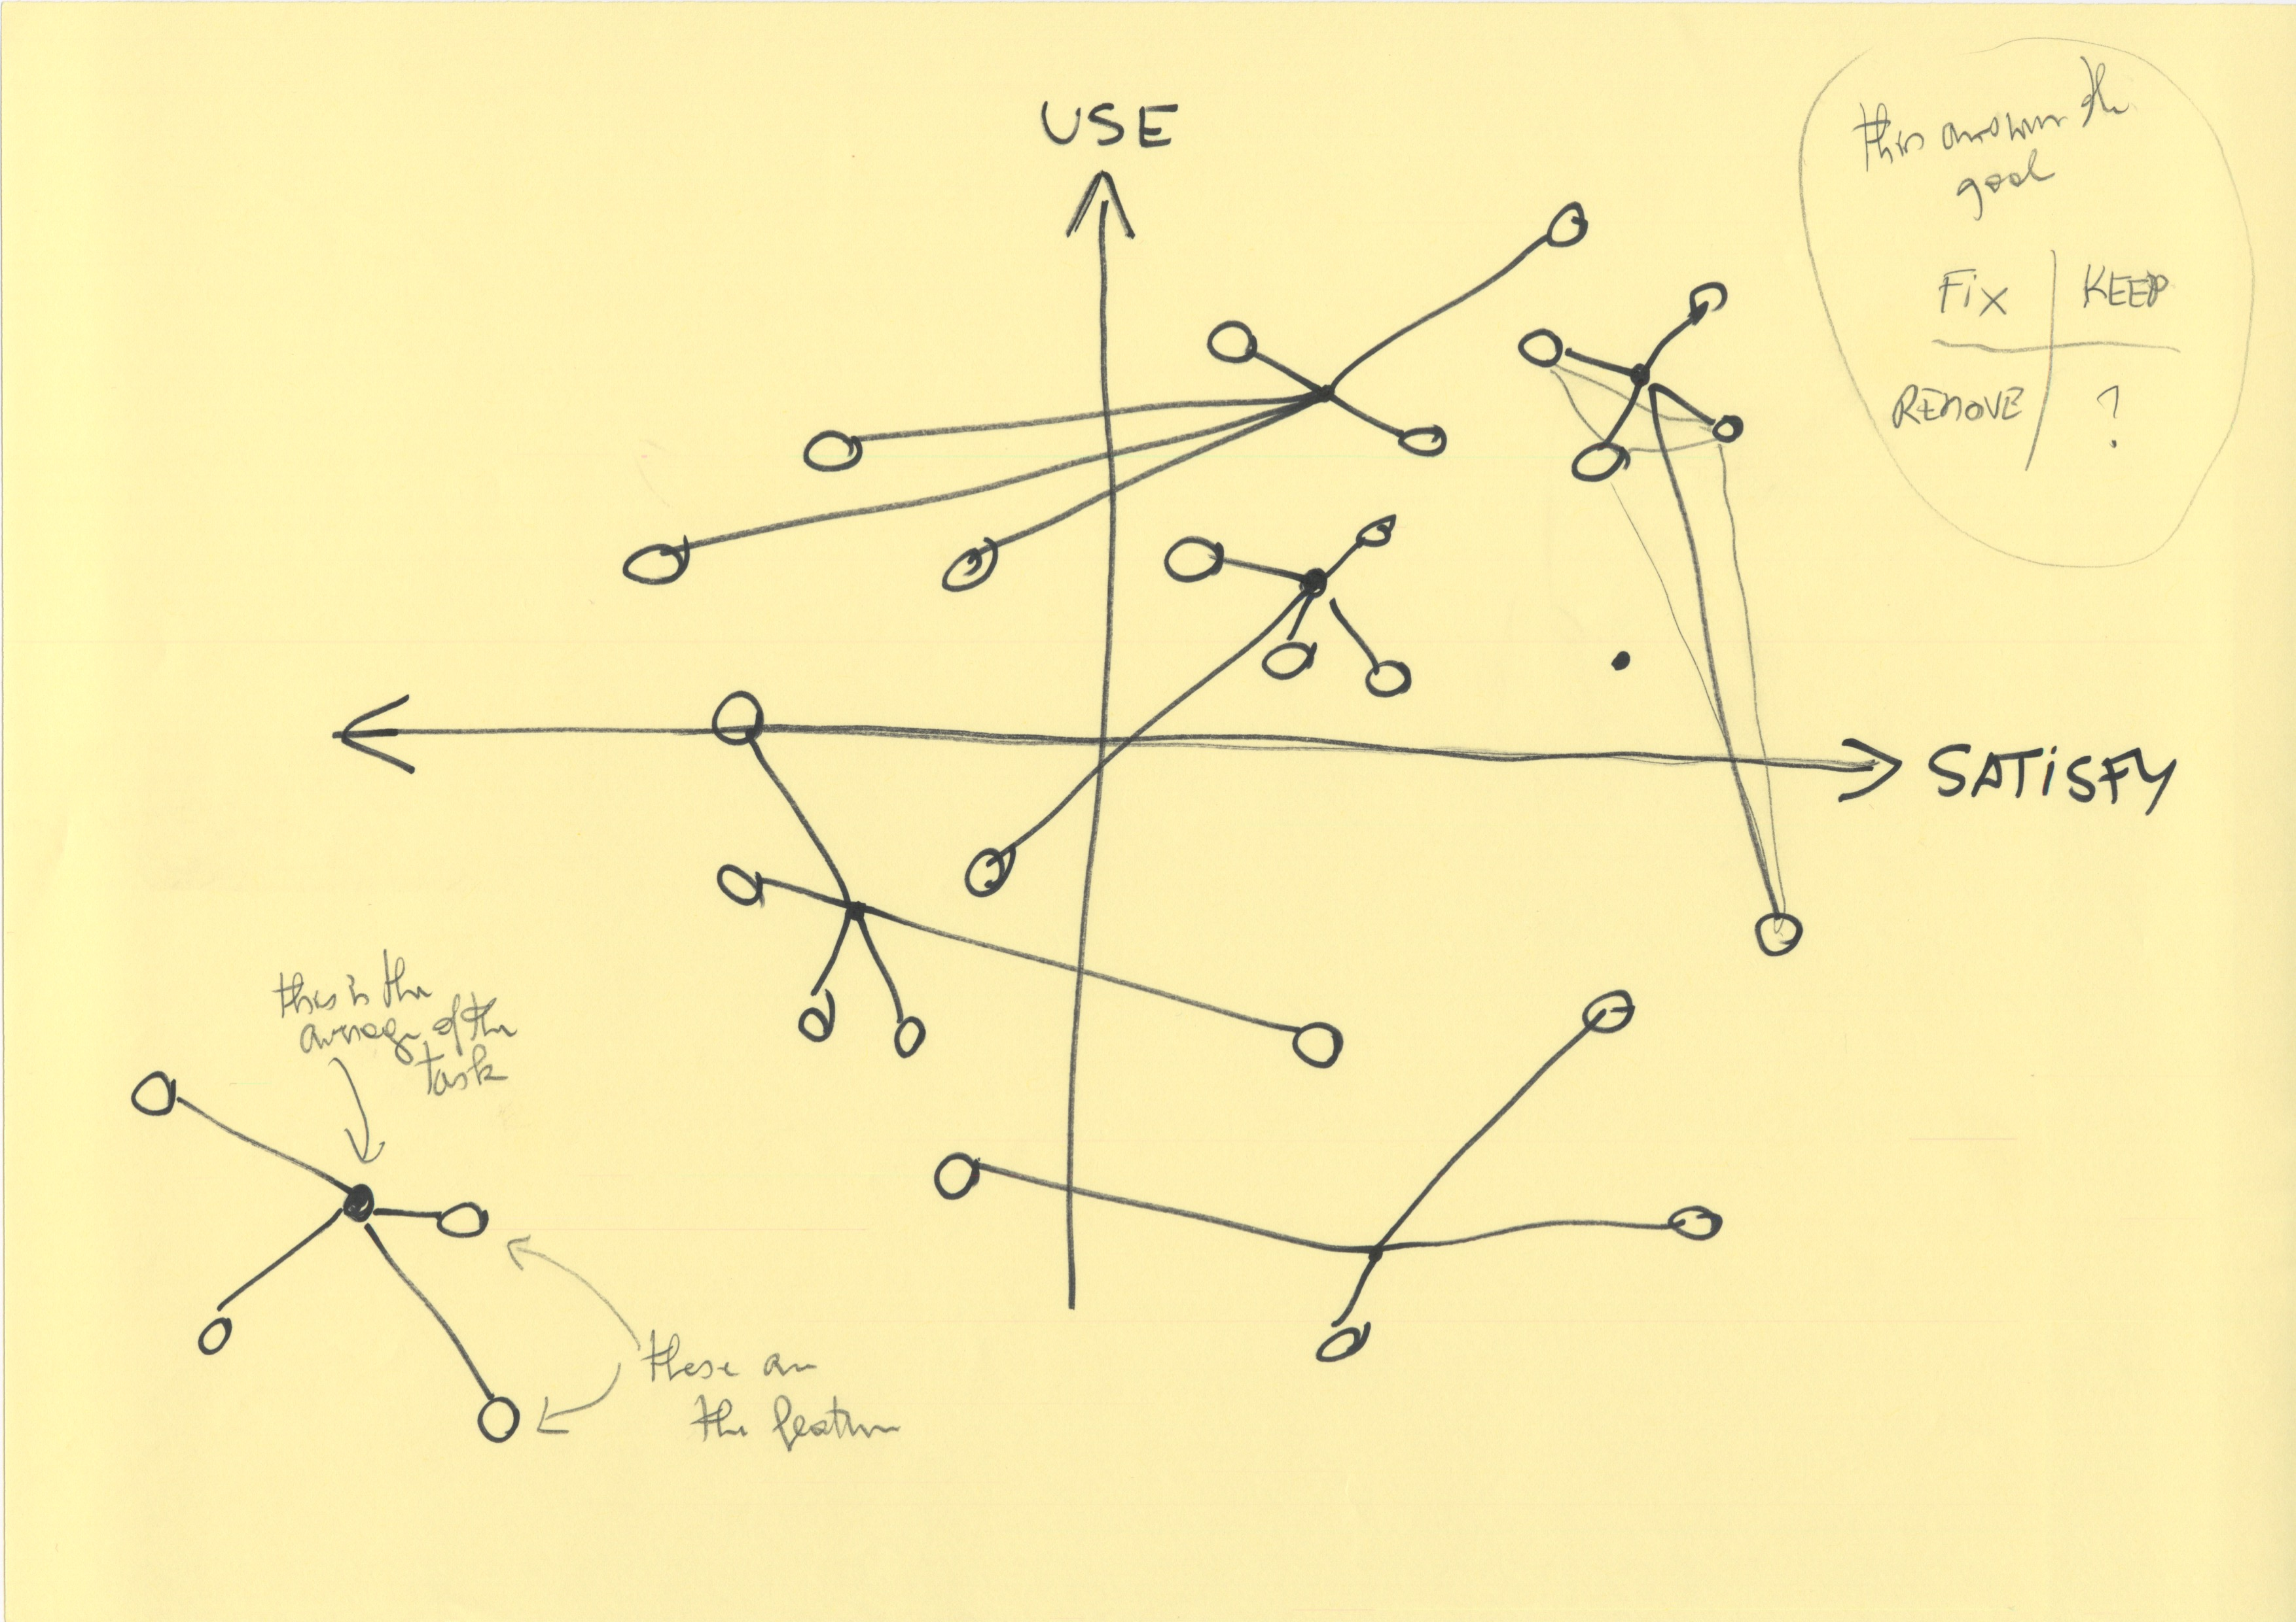
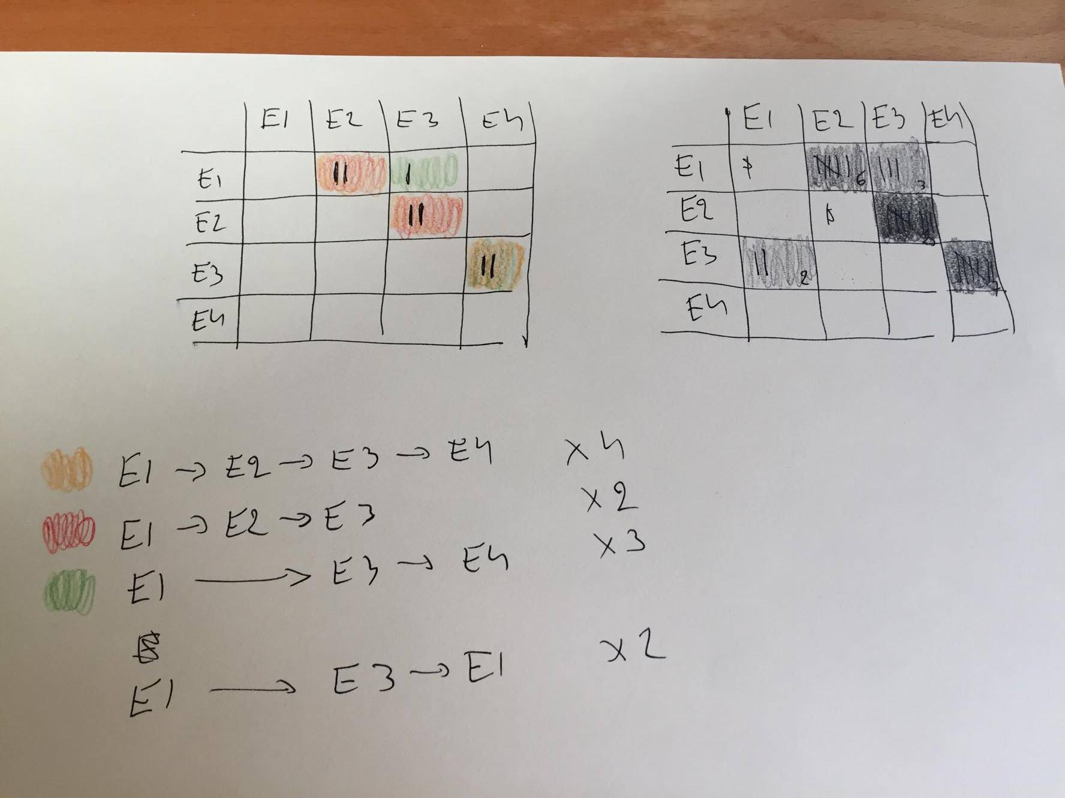
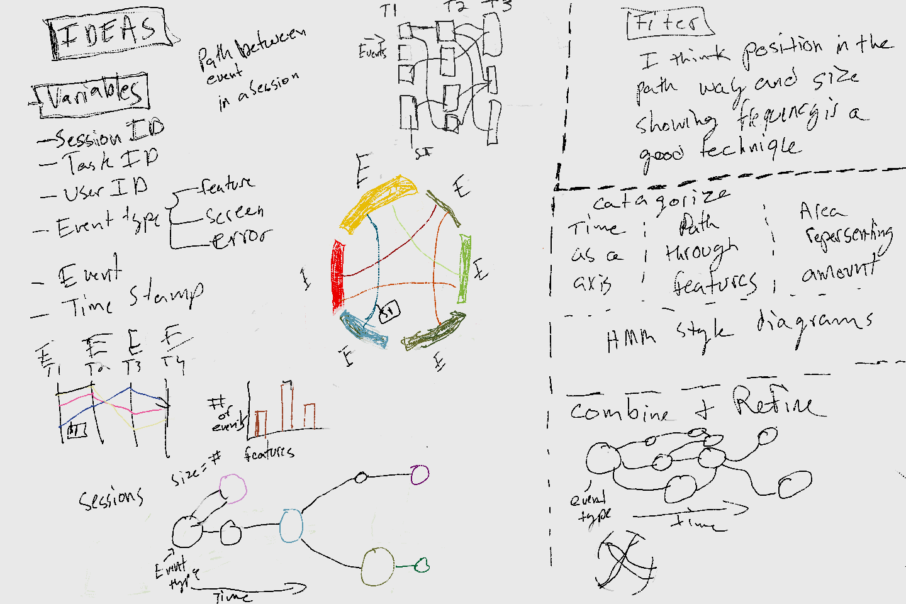
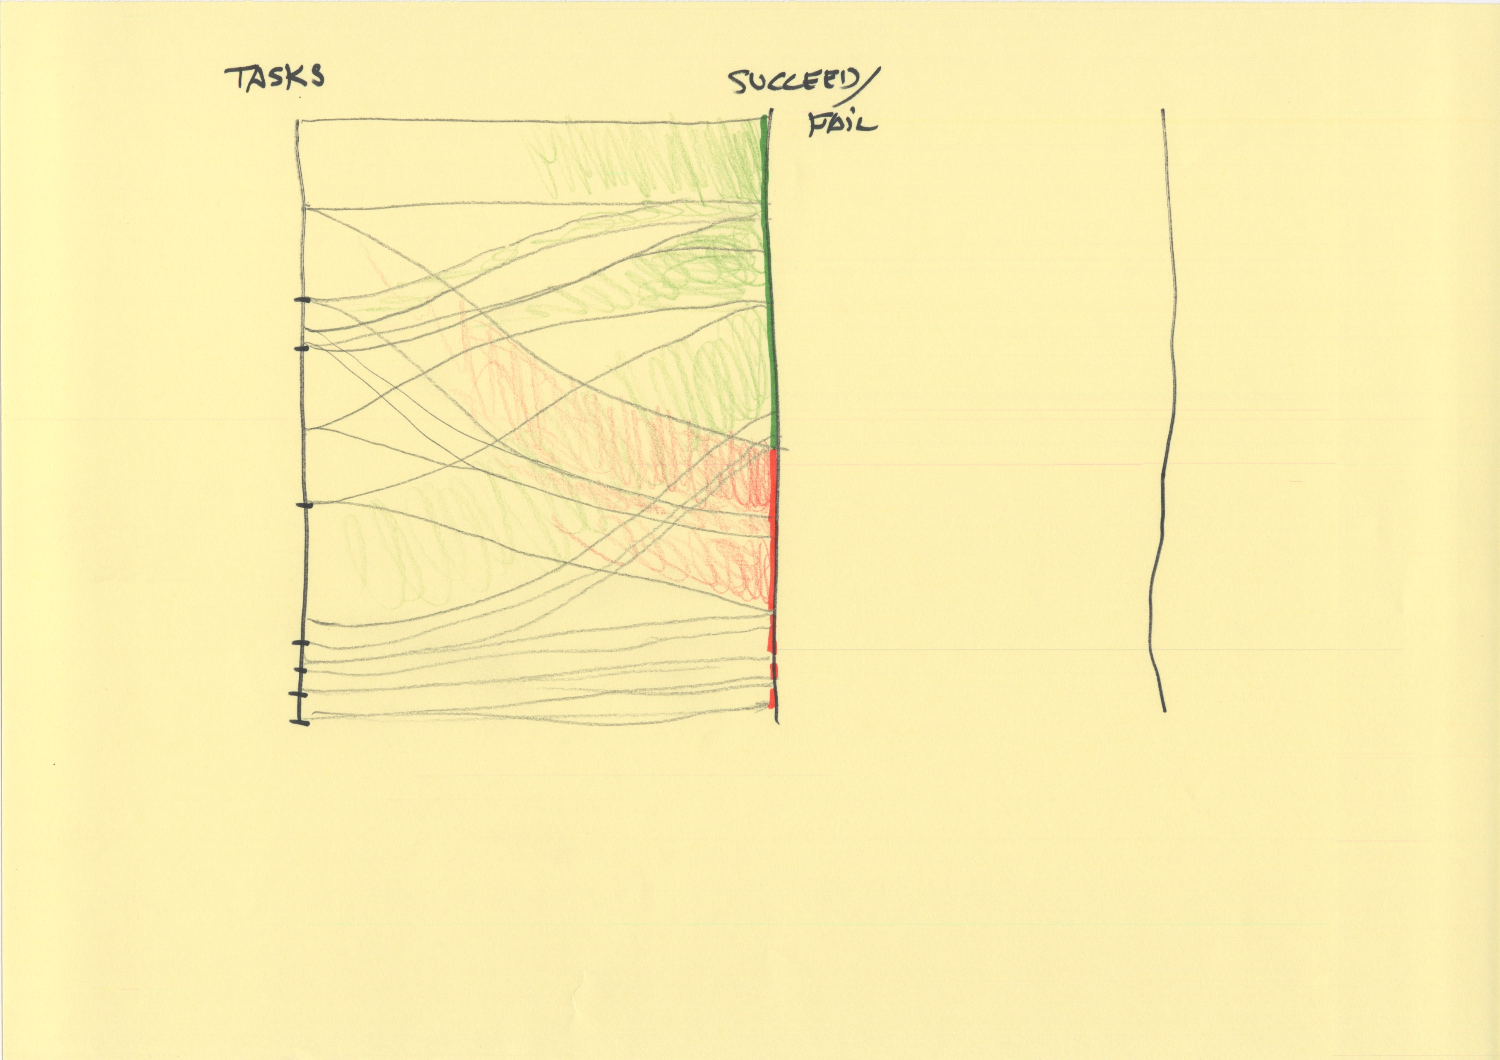
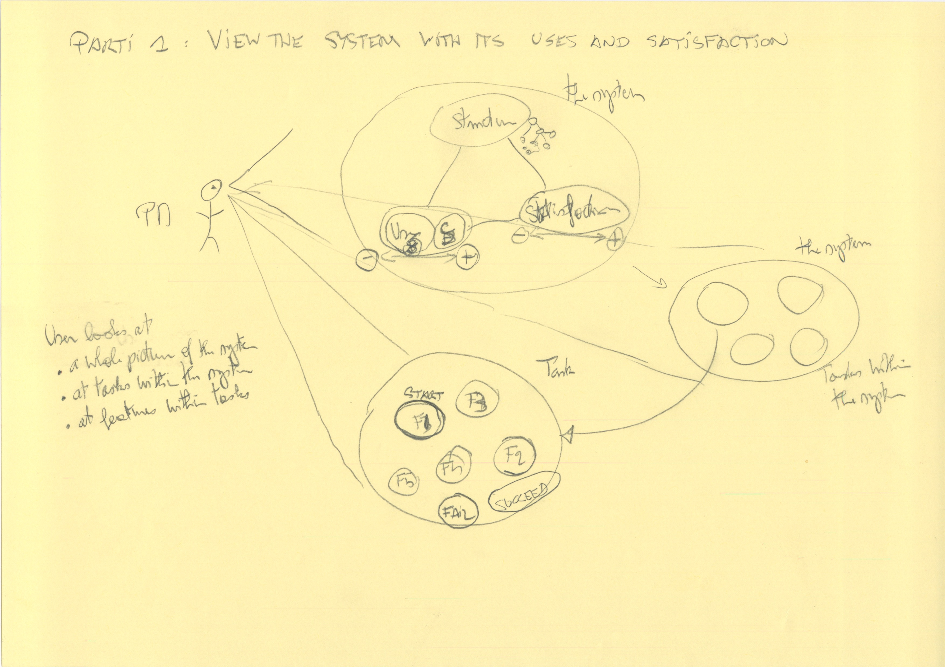
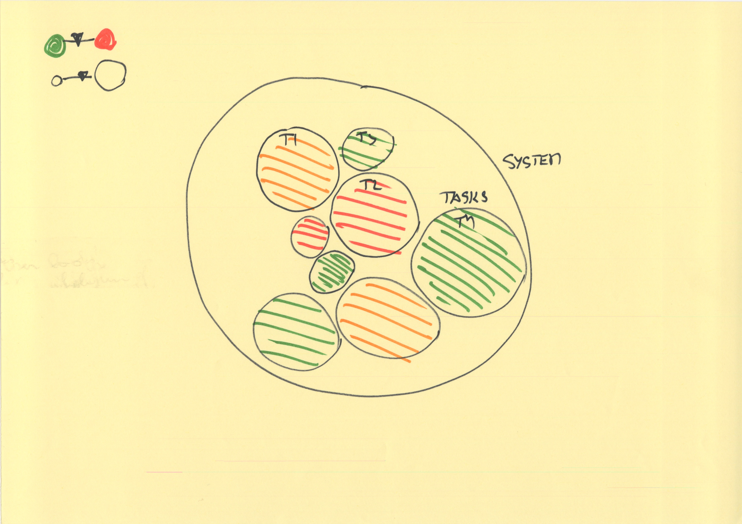
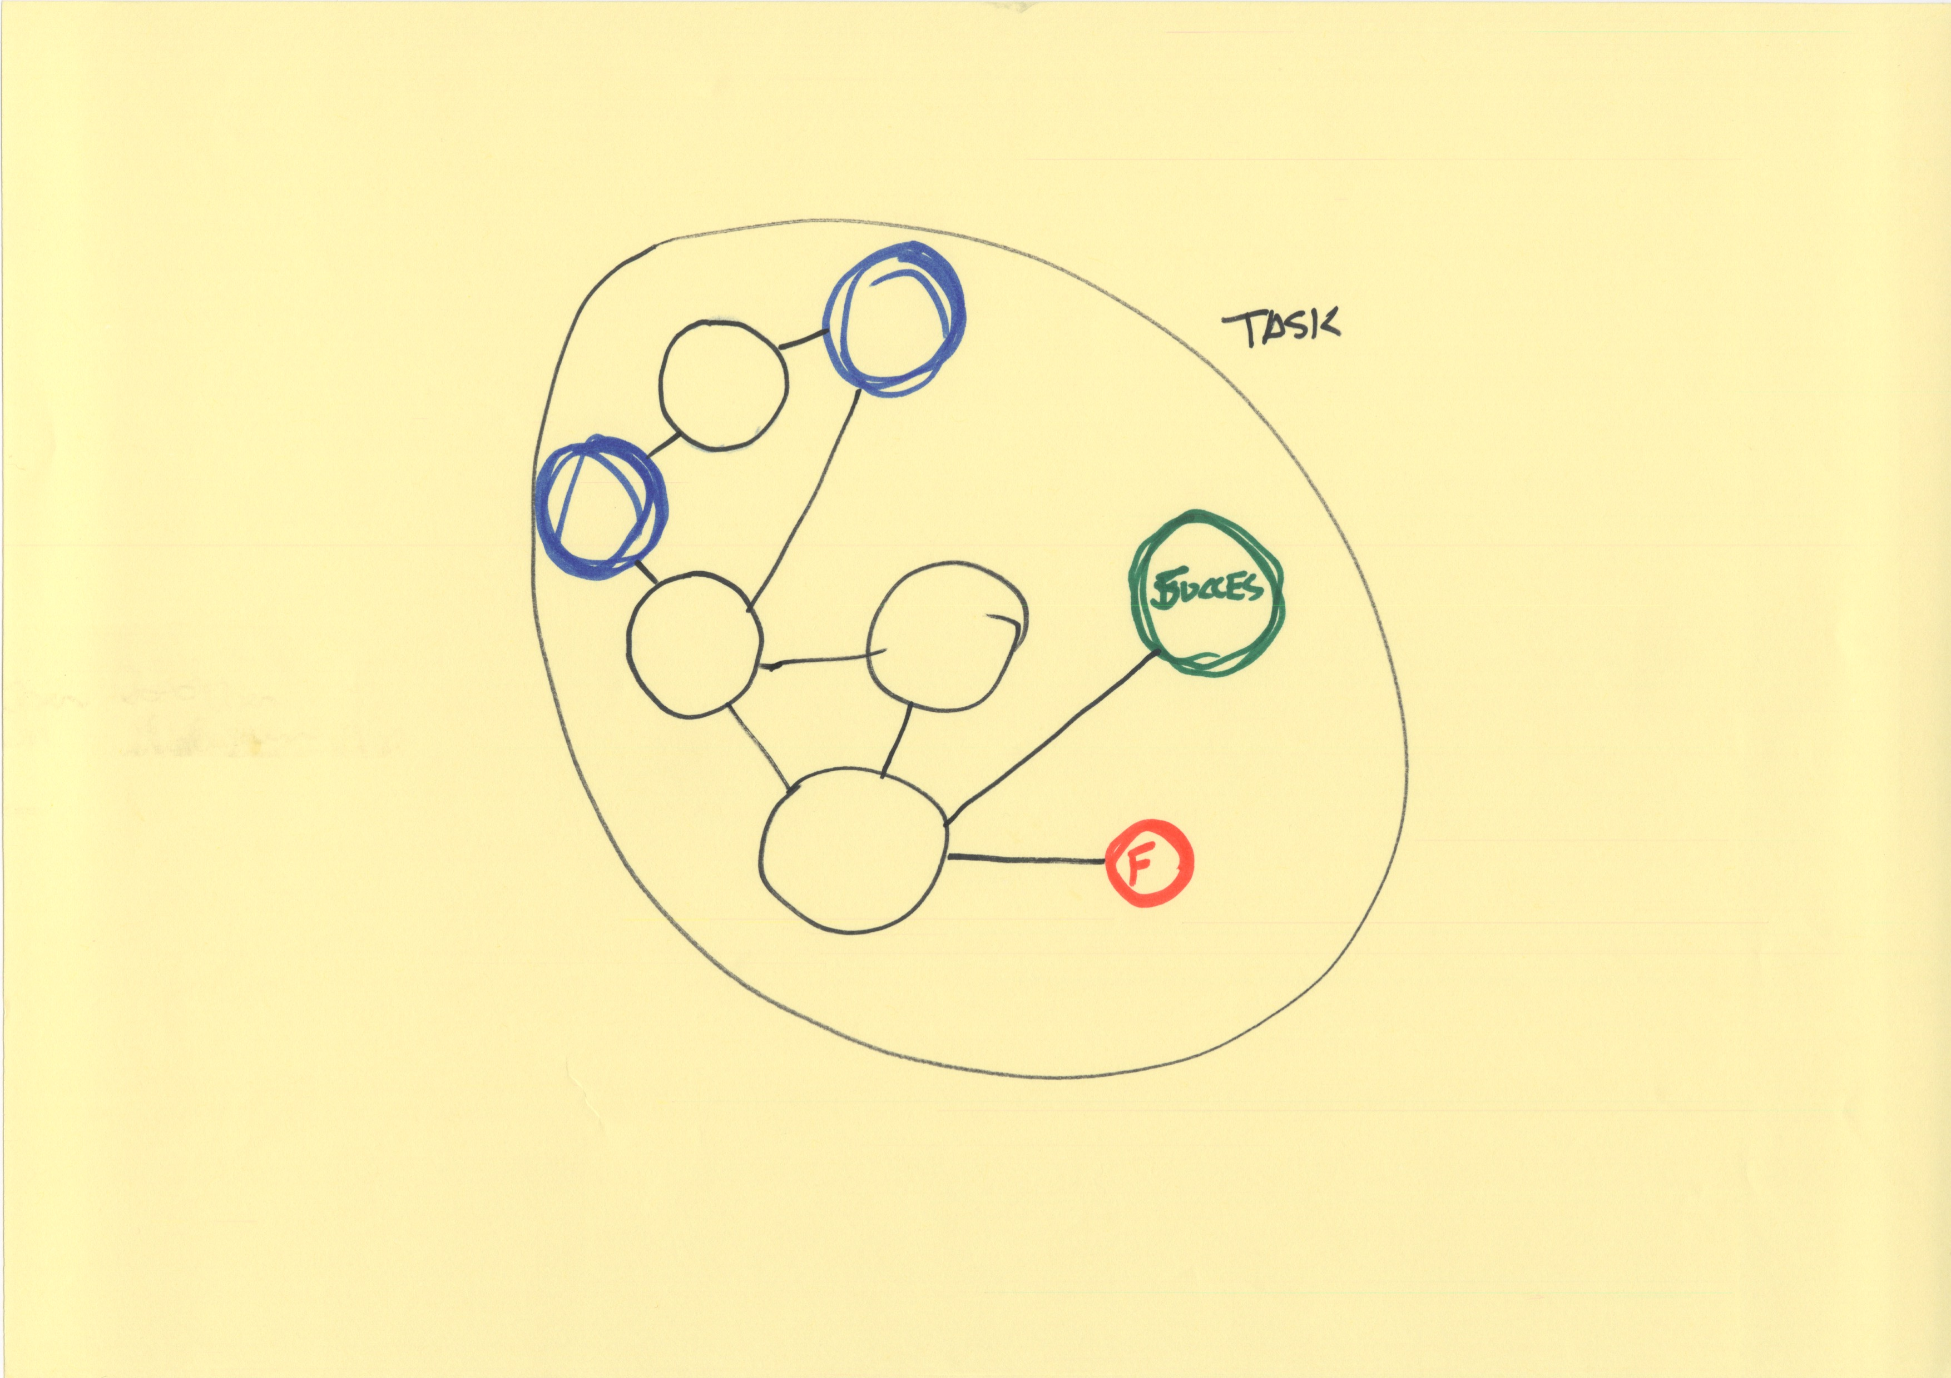
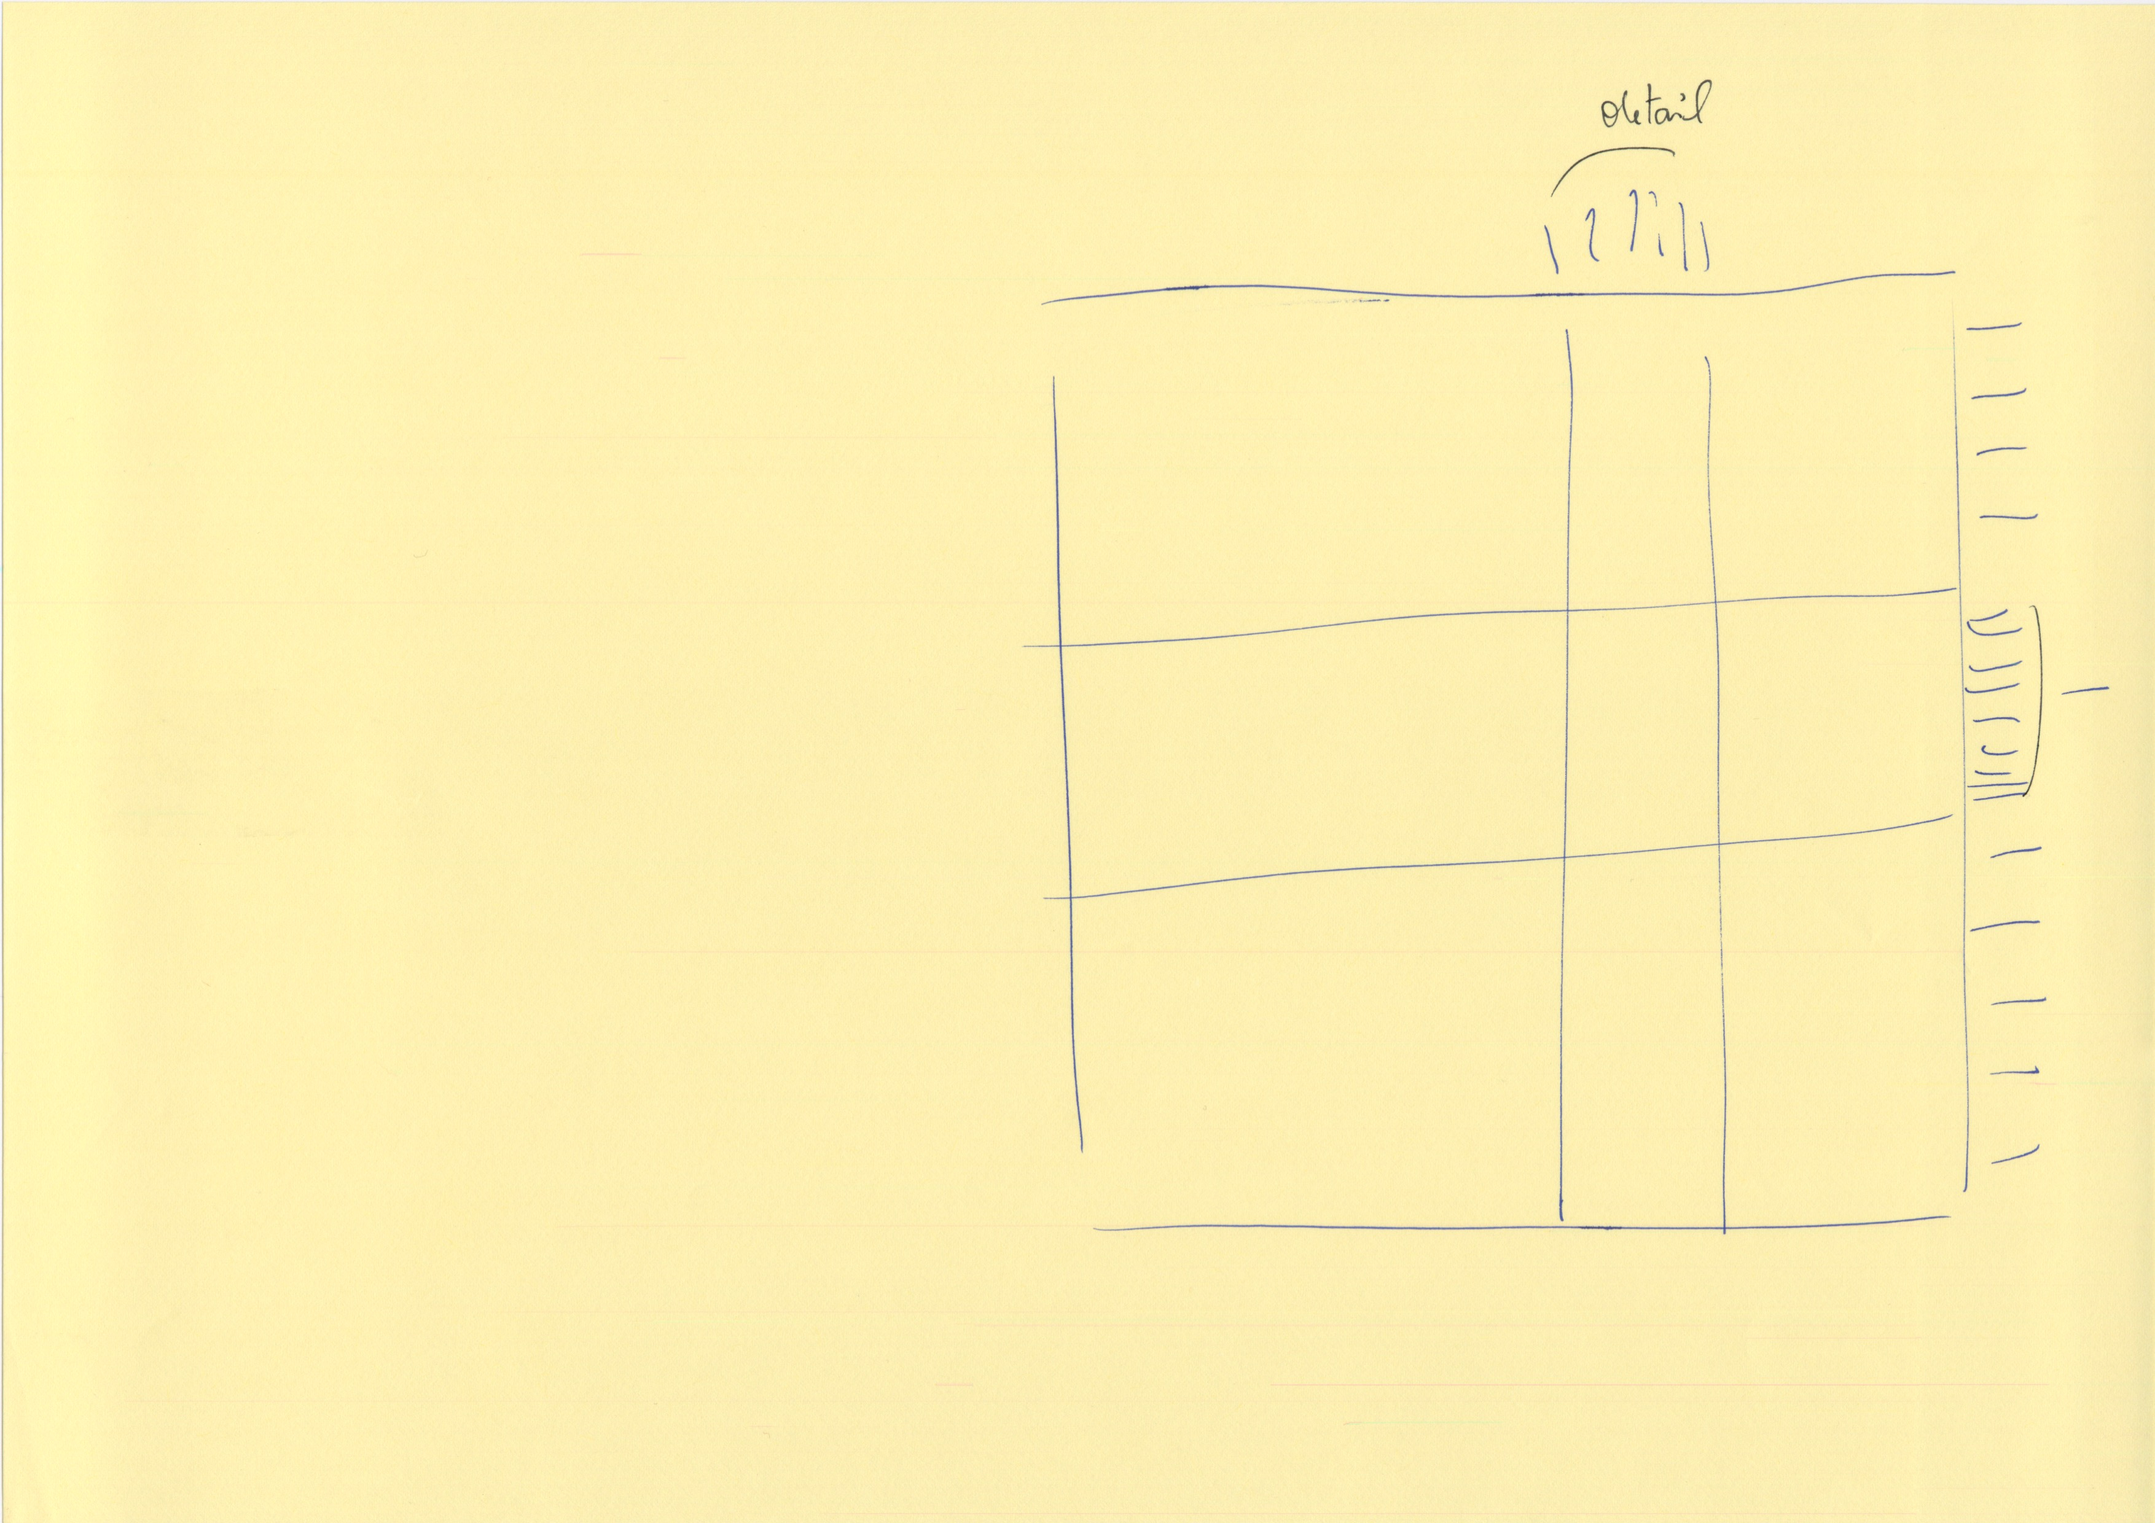
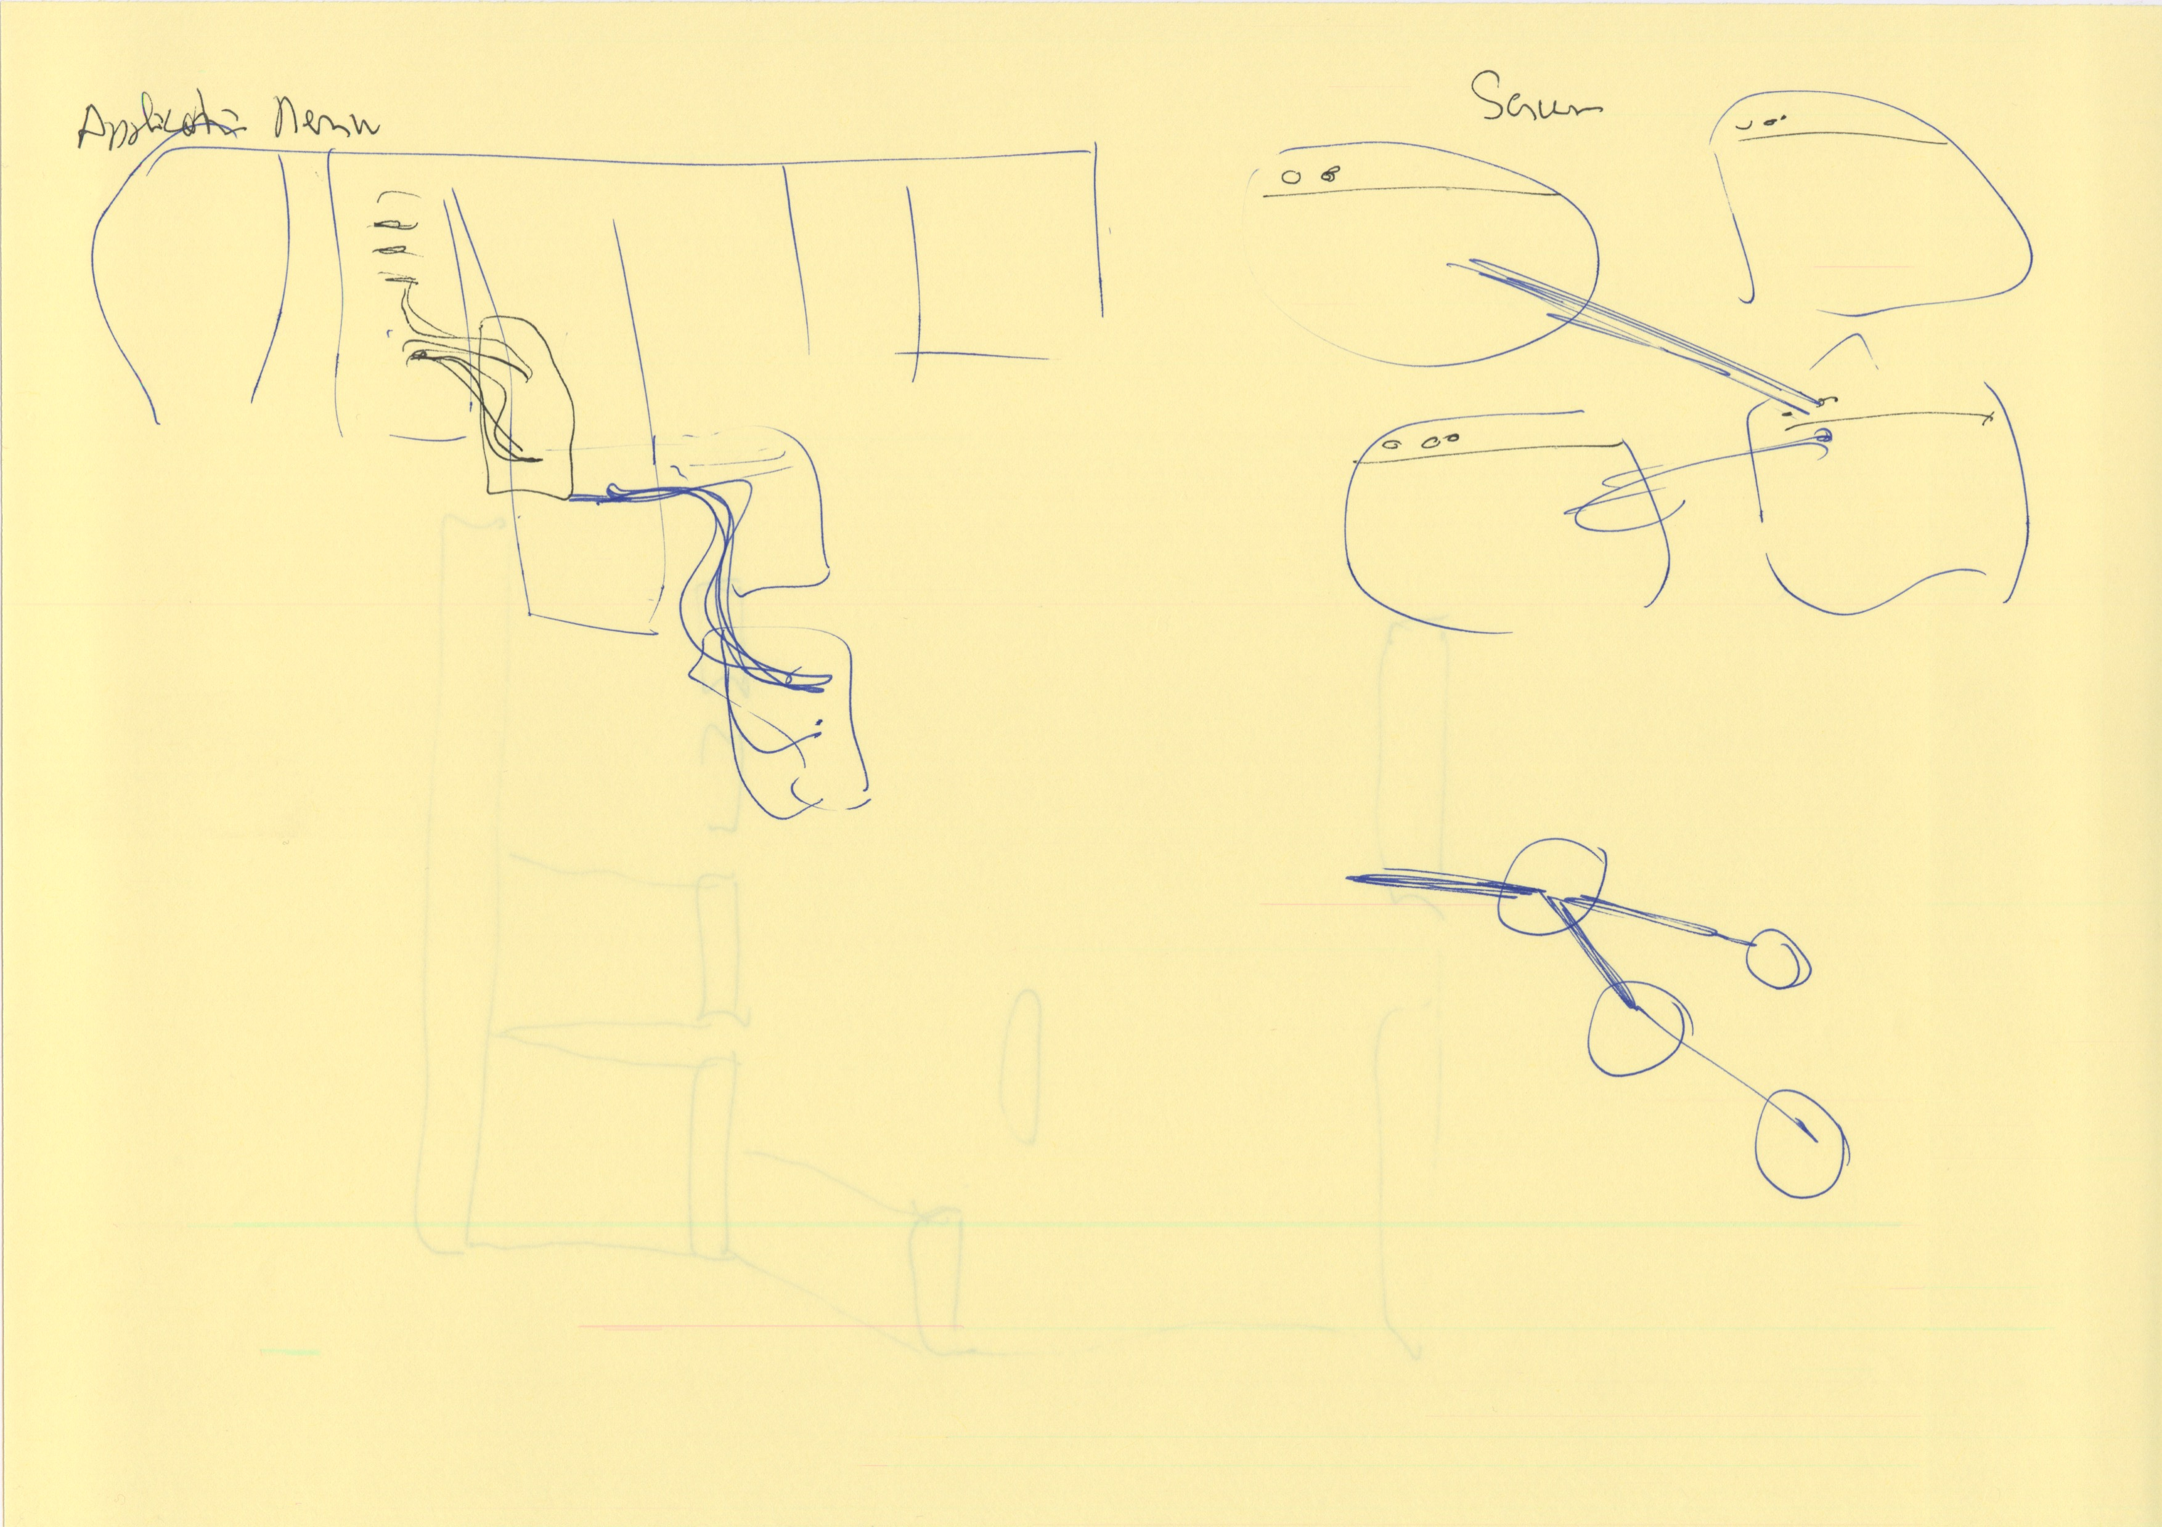
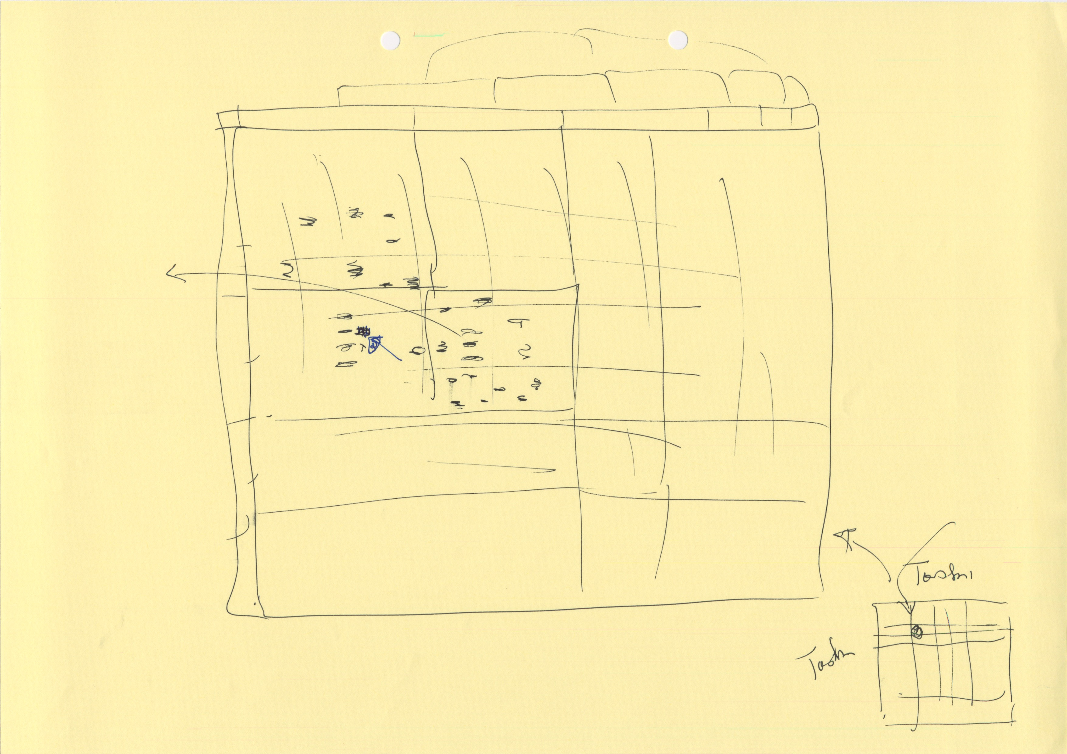
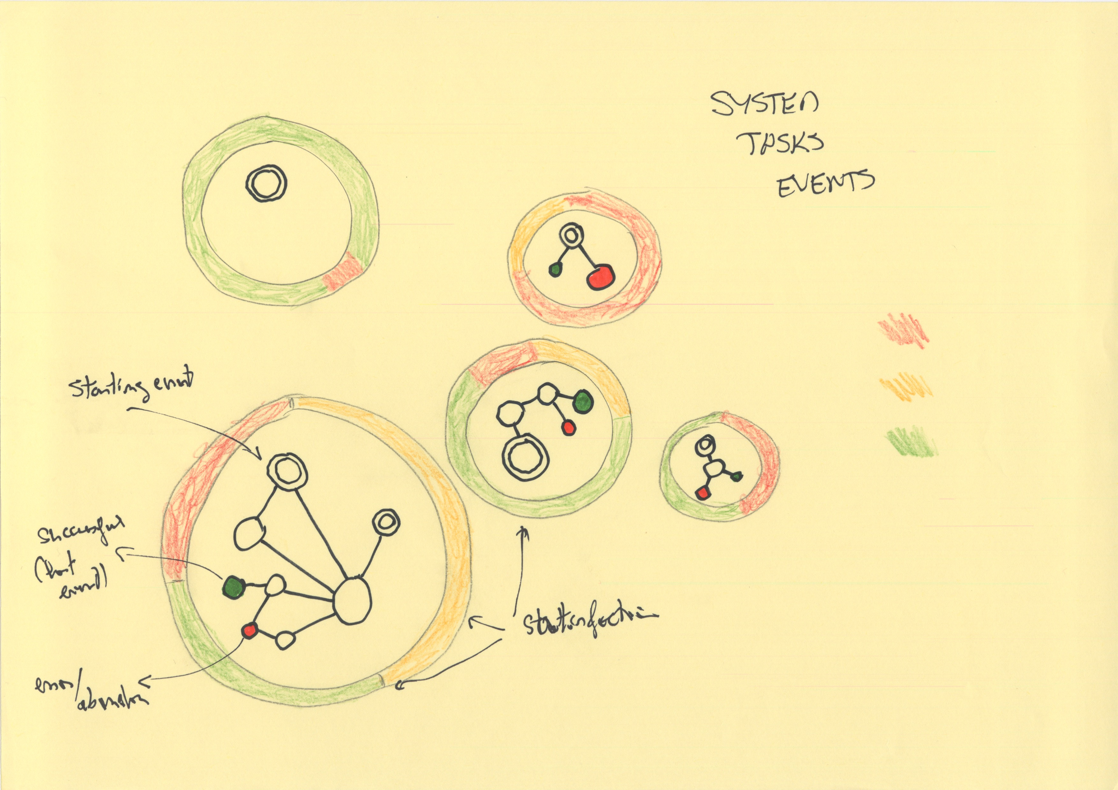

Slide 7
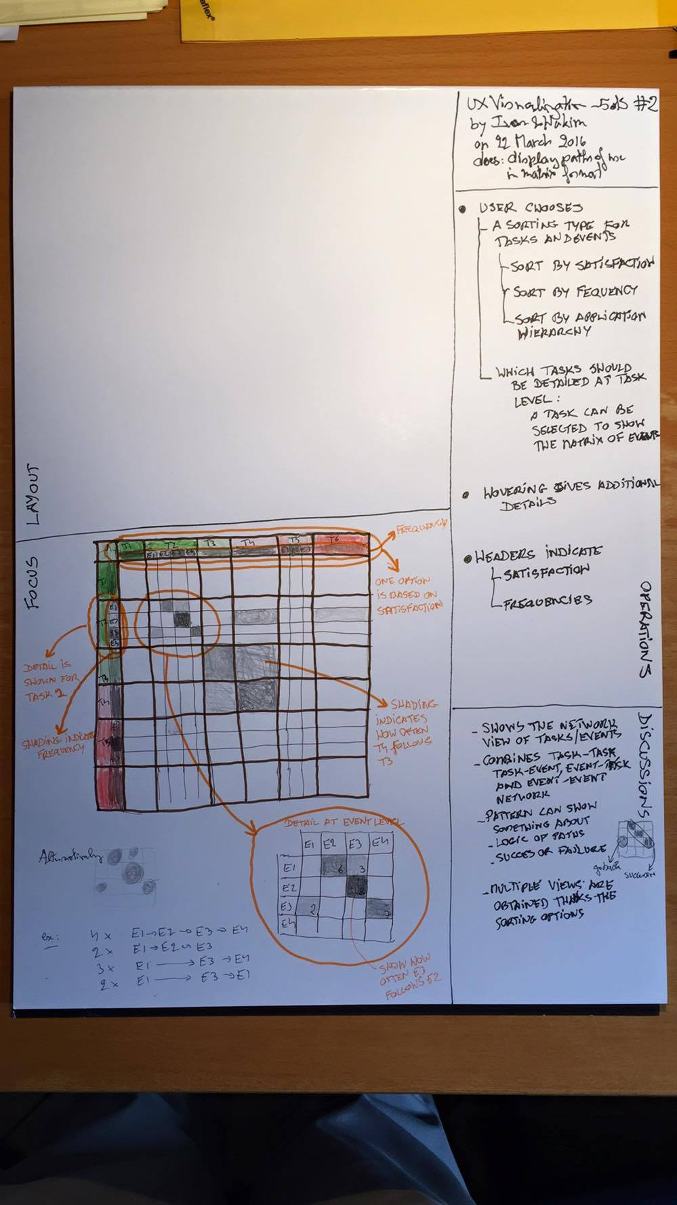
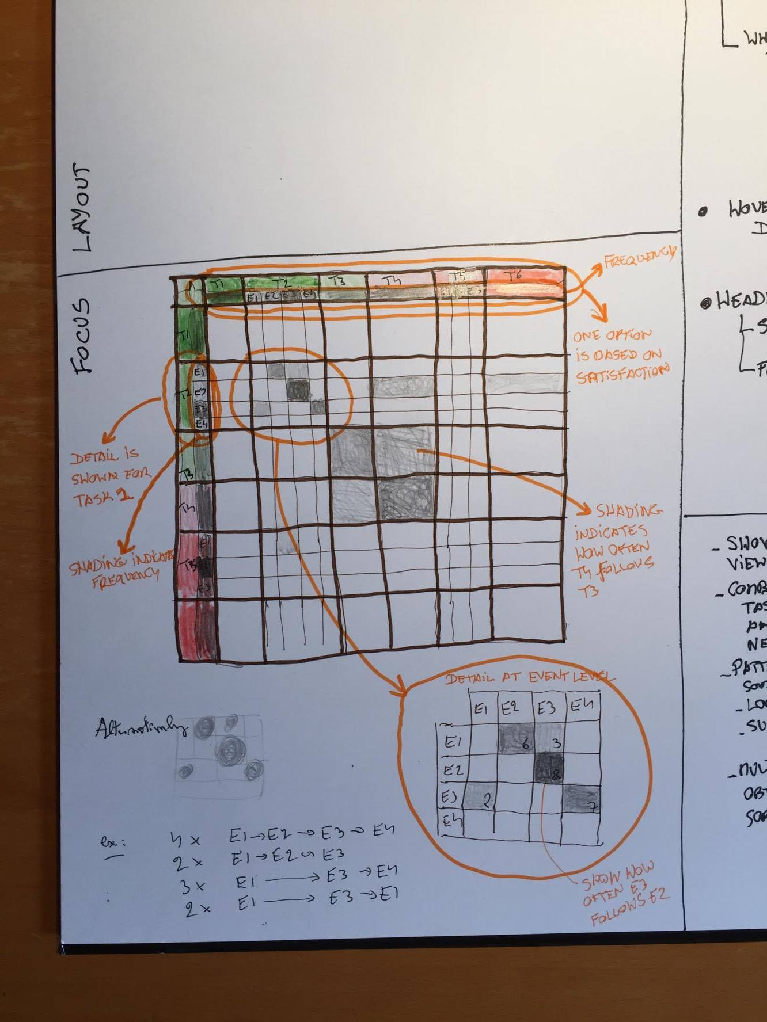

Slide 8
